Slide 1
Unit Objectives
At the end of this lesson, you should be able to:
  Describe chain of command and formal communication relationships.
  Identify common leadership responsibilities and values.
  Describe span of control and modular development.
  Describe the use of position titles.

Slide 2
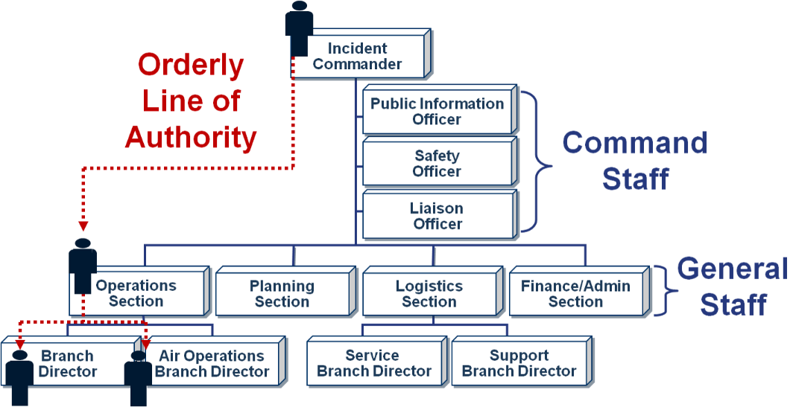
Chain of Command
An orderly line of authority is used for the flow of task assignments and resource requests. This line of authority flows down through the organizational structure.

Slide 3

Unity of Command
Unity of command means that each individual involved in incident operations will be assigned – and will report – to only one supervisor.
Chain of command and unity of command help to ensure that clear reporting relationships exist and eliminate the confusion caused by multiple, conflicting directives. Incident managers at all levels must be able to control the actions of all personnel under their supervision.
Unity of command clears up many of the potential communication problems encountered in managing incidents or events because each individual maintains a formal communication relationship only with his or her immediate supervisor.
Don't confuse unity of command with Unified Command!

Slide 4
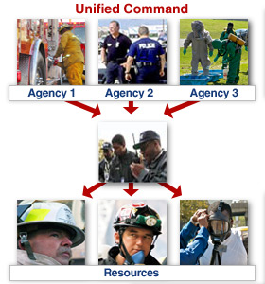
Unified Command (1 of 2)
When no one jurisdiction, agency, or organization has primary authority and/or the resources to manage an incident on its own, Unified Command may be established. There is no one "Commander." The Unified Command can allocate resources regardless of ownership or location.
This illustration shows three responsible agencies managing an incident together under a Unified Command.

Slide 5

Unified Command (2 of 2)
Unified Command:
  Enables all responsible agencies to manage an incident together by establishing a common set of incident objectives and strategies
  Allows Incident Commanders to make joint decisions by establishing a single command structure at one Incident Command Post (ICP)
  Maintains Unity of Command. Each employee reports to only one supervisor

Slide 6

Advantages of Unified Command
Advantages of using Unified Command include:
  A single set of objectives guides incident response.
  A collective approach is used to develop strategies to achieve incident objectives.
  Information flow and coordination are improved between all involved in the incident.
  All agencies have an understanding of joint priorities and restrictions.
  No agency's legal authorities will be compromised or neglected.
  Agencies' efforts are optimized as they perform their respective assignments under a single Incident Action Plan.

Slide 7
Activity 2.1: Unified Command
Activity Purpose: To practice recognizing potential incident management issues.
Time: 15 minutes
Instructions: Working with your team
  Read the scenario in your Student Manual.
  Identify the potential incident management issues.
  List the incident management issues on chart paper.
  Choose a spokesperson. Be prepared to present your findings to the class in 10 minutes.
Scenario:
A tornado collapsed a building, trapping 15 people in its basement. Fire department officers immediately designated a fire station located directly across from the incident site as the Incident Command Post (ICP). However, the fire station’s confined location and immediate proximity to the incident made it ill-suited for directing the large-scale response effort. As police officers arrived on the scene, they decided to establish their Command Center at a school, several blocks away from the immediate response activities.
As response operations progressed and a mobile command vehicle became available, the Incident Command Post (ICP) was established in that vehicle just north of the hospital. Other agencies involved, such as the fire department and emergency medical services, began operating near the new ICP location and Incident Commander. The police department continued to operate from the school.

Slide 8
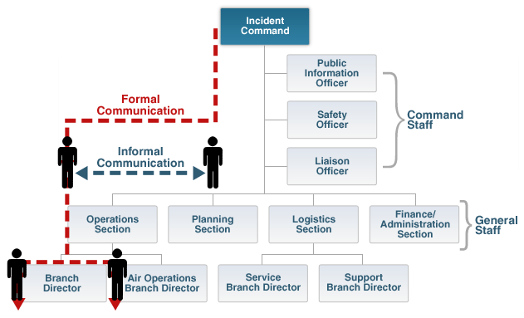
Integrated Communications Overview
Formal communications follow the lines of authority. However, information concerning incident or event can be passed horizontally or vertically within the organization without restriction.
Link to full description of organizational chart.

Slide 9

Formal Communication
As illustrated on the previous screen, formal communication must be used when:
  Receiving and giving work assignments
  Requesting support or additional resources
  Reporting progress of assigned tasks
Other information concerning the incident or event can be passed horizontally or vertically within the organization without restriction. This is known as informal communication.

Slide 10

Informal Communication
Informal communication:
  Is used to exchange incident or event information only
  Is NOT used for:
    Formal requests for additional resources
    Tasking work assignments
Within the ICS organization, critical information must flow freely!

Slide 11
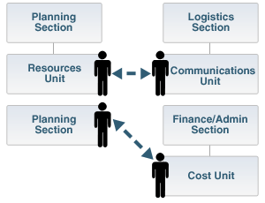
Informal Communication (Continued)
Examples of informal communication are as follows:
  The Communications Unit Leader may directly contact the Resources Unit Leader to determine the number of persons requiring communications devices.
  The Cost Unit Leader may directly discuss and share information on alternative strategies with the Planning Section Chief.

Slide 12
Activity 2.2: Incident Communications
Activity Purpose: To practice identifying communication strategies to avoid problems during incident operations.
Time: 15 minutes
Instructions: Working with your team
  Read the scenario in your Student Manual.
  Identify strategies to address the communications problem.
  List the strategies on chart paper.
  Choose a spokesperson. Be prepared to present your findings to the class in 10 minutes.
Case Scenario:
Emergency communications at the Pentagon site proved challenging on September 11, 2001. Radio communications among emergency responders quickly became overloaded. These communication problems persisted throughout rescue operations. There was a need to record the identification number and location of each piece of equipment on the Pentagon grounds. Radio communications could not be employed to perform this task.

Slide 13

Discussion Question
Why is leadership an essential element of successful incident/event management?

Slide 14
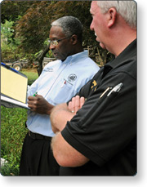
Common Leadership Responsibilities
A good leader:
  Communicates by giving specific instructions and asking for feedback.
  Supervises the scene of action.
  Evaluates the effectiveness of the plan.
  Understands and accepts the need to modify plans or instructions.
  Ensures safe work practices.
  Takes command of assigned resources.
  Motivates with a "can do safely" attitude.
  Demonstrates initiative by taking action.

Slide 15

Leadership & Values
A leader commits to excellence in all aspects of his or her professional responsibility. Leaders should know, understand, and practice the leadership responsibilities and recognize the relationship between these responsibilities and the leadership values. Commitment to duty, respect, and integrity are essential values that must be demonstrated in order for a leader to be effective.

Slide 16
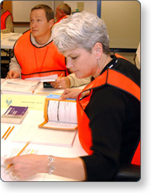
Commitment to Duty
Duty begins with everything required by law and policy, but it is much more than simply fulfilling requirements.
How does an effective leader demonstrate commitment to duty to those he or she leads?
An effective leader should try to:
  Take charge within his or her scope of authority.
  Be prepared to step out of a tactical role to assume a leadership role.
  Be proficient in his or her job.
  Make sound and timely decisions.
  Ensure tasks are understood.
  Develop subordinates for future events.

Slide 17
Discussion Question
What can you do to demonstrate your commitment to duty to those you lead?

Slide 18
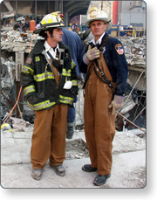
Leadership & Respect
In order to maintain leadership and respect, a leader should:
  Know his or her subordinates and look out for their well-being. A leader’s workforce is his or her greatest resource. Not all workers will succeed equally, but they all deserve respect.
  Keep his or her subordinates and supervisor informed by providing accurate and timely briefings and giving the intent behind assignments and tasks.
  Build the team. Conducting frequent briefings and debriefings with the team enables a leader to monitor progress and identify lessons learned. Considerations made during these meetings should include team experience, fatigue, and physical limitations when accepting assignments.

Slide 19
Activity 2.3: Incident Leadership
Activity Purpose: To stimulate thought and discussion about desirable leadership qualities.
Time: 20 minutes
Instructions: Working with your team
  Identify a highly effective incident leader you have known or know about.
  List the main leadership qualities that such an individual must possess.
  State how these qualities relate to leadership in incident response.
  Choose a spokesperson. Be prepared to present your findings to the class in 5 minutes.

Slide 20

Communication Responsibilities
To ensure sharing of critical information, all responders must:
  Brief others as needed
  Debrief their actions
  Communicate hazards to others
  Acknowledge messages
  Ask if they do not know
While not always possible, the most effective form of communication is face-to-face.

Slide 21
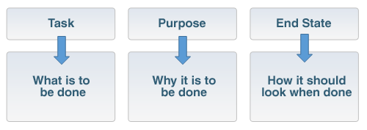
Briefing Elements
Provide complete briefings that include clearly stated objectives and the following elements:

Slide 22

Incident Management Assessment
Assessment is an important leadership responsibility and is conducted after a major activity in order to allow employees and leaders to discover what happened and why. Assessment methods include:
  Corrective action report/After-Action Review (AAR)
  Debriefing
  Post-incident critique
  Mitigation plans

Slide 23
Discussion Question
What questions would you use to assess the effectiveness of incident management?

Slide 24

Using Common Terminology
ICS establishes common terminology that allows diverse incident management and support entities to work together.
Major functions and functional units with incident management responsibilities are named and defined. Terminology for the organizational elements involved is standard and consistent.

Slide 25

ICS Organization: Review
The ICS organization:
  Is typically structured to facilitate activities in five major functional areas: Command, Operations, Planning, Logistics, and Finance/Administration
  Is adaptable to any emergency or incident to which domestic incident management agencies would be expected to respond
  Has a scalable organizational structure that is based on the size and complexity of the incident
However, this flexibility does NOT allow for the modification of the standard, common language used to refer to organizational components or positions.

Slide 26
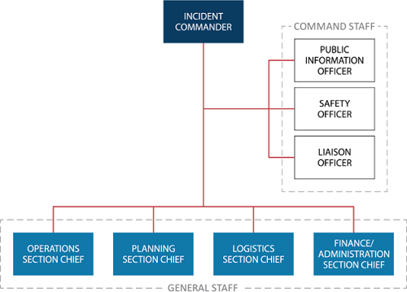
ICS Organization: Review (Continued)
Who's responsible for what?

Slide 27

NIMS Management: Manageable Span of Control
The optimal span of control for incident management is one supervisor to five subordinates; however, effective incident management frequently necessitates ratios significantly different from this. The 1:5 ratio is a guideline, and incident personnel use their best judgment to determine the actual distribution of subordinates to supervisors for a given incident or EOC activation.

Slide 28
Span of Control
What influences span of control?

Slide 29
Modular Organization
The ICS organization adheres to a "form follows function" philosophy. The size of the current organization and that of the next operational period is determined through the incident planning process.
Because the ICS is a modular concept, managing span of control is accomplished by organizing resources into Teams, Divisions, Groups, Branches, or Sections. When the supervisor-to-subordinate ratio exceeds manageable span of control, additional Teams, Divisions, Groups, Branches, or Sections can be established. When a supervisor is managing too few subordinates, Sections, Branches, Divisions, Groups, or Teams can be reorganized or demobilized to reach a more effective span of control.

Slide 30
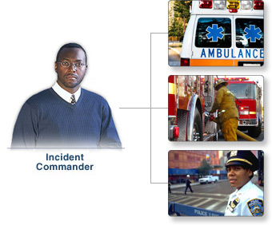
Typical Organizational Structure
The initial response to most domestic incidents is typically handled by local "911" dispatch centers, emergency responders within a single jurisdiction, and direct supporters of emergency responders. Most responses need go no further.
Approximately 95% of all incidents are small responses that include:
  Command: Incident Commander and other Command Staff
  Single Resource: An individual, a piece of equipment and its personnel complement, or an established crew or team of individuals with an identified work supervisor that can be used on an incident

Slide 31
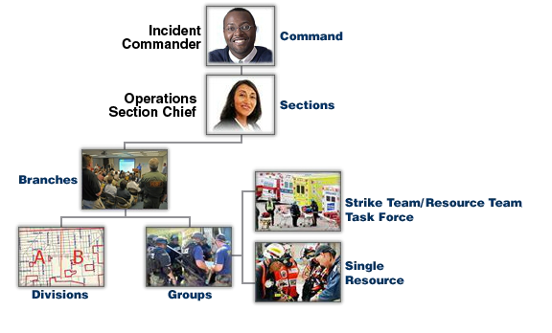
Expanding Incidents
Incidents that begin with single resources may rapidly expand requiring significant additional resources and operational support.

Slide 32

Use of Position Titles
At each level within the ICS organization, individuals with primary responsibility positions have distinct titles. Using specific ICS position titles serves these important purposes:
  Provides a common standard
  Ensures qualified individuals fill positions
  Ensures that requested personnel are qualified
  Standardizes communication
  Describes the responsibilities of the position

Slide 33
ICS Supervisory Position Titles
Titles for all ICS supervisory levels are shown in the table below:
Organizational Level | Title | Support Position
Incident Command | Incident Commander | Deputy
Command Staff | Officer | Assistant
General Staff (Section) | Chief | Deputy
Branch | Director | Deputy
Division/Group | Supervisor | N/A
Unit | Unit Leader | Manager
Strike Team/Task Force | Leader | Single Resource Boss

Slide 34
Discussion Question
How you would adjust the organizational strategy to maintain span of control for the scenario below? Be sure to use proper principles, position titles, and features.
Scenario: The Command Staff consists of a Safety Officer and Public Information Officer. In the General Staff, the Operations Section has seven Strike Teams under the supervision of one Leader. Each Strike Team consists of a mix of different types of law enforcement and medical resources.

Slide 35
Lesson Completion
You have completed the Incident Command and Unified Command lesson. You should now be able to:
  Describe chain of command and formal communication relationships.
  Identify common leadership responsibilities and values.
  Describe span of control and modular development.
  Describe the use of position titles.
The next lesson will discuss delegation of authority and management by objectives.

